Slide 1
Stat 495r – Presenting Data
Week 12 – officer and scales

Slide 2
Announcements
Tableau Homework Grading
Sent graphics to Deseret News
No class next week (Week 13)
Next up:
Week 14 - Maps and Interactivity
Week 15 – RShiny
Data Science Club – Today at 7pm – Topic is Conjoint
https://byu.zoom.us/j/97615868295

Slide 3
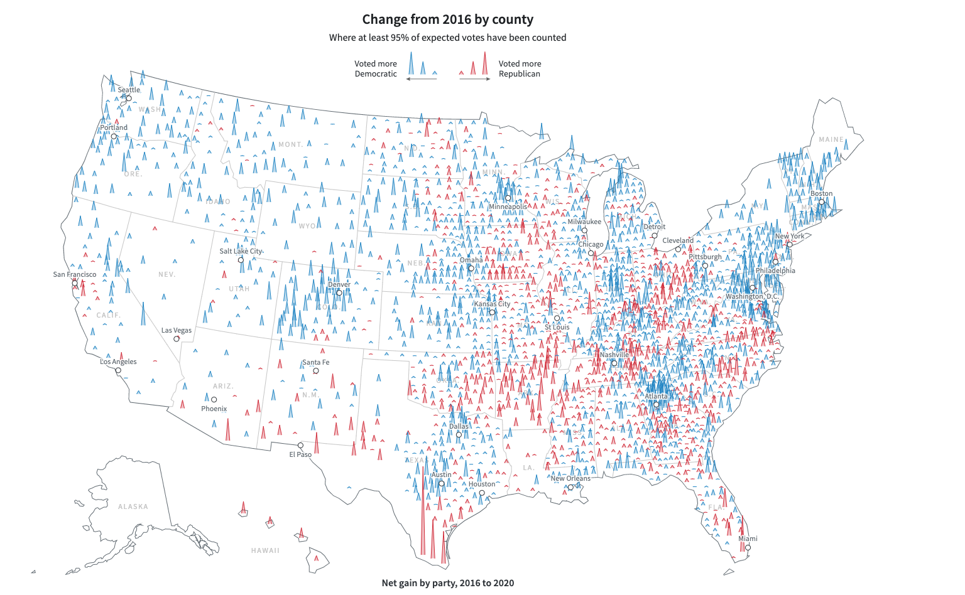
Data Viz #1
Notes:
This is called a tree map
What aesthetics are used?
When else can tree maps be usefule?

Slide 4
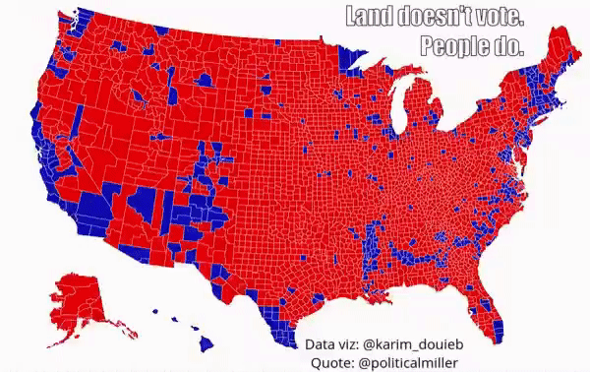
Data Viz #2
Notes:
Warning: English accent: “Borough”
How can iterations with new aesthetics improve visuals and storytelling?

Slide 5

Data Viz #3
Notes:
What’s wrong?
What is the aesthetic?
Without thinking about it, what is the takeaway? “Humans cause the most fires, but lightning burns the most area”

Slide 6
officer package

Slide 7

Why Automate PowerPoint?
You need to create a whole bunch of slightly different slides
You make the same report, over and over again, but with different data
You have a bunch of ggplots and you want them to fit perfectly into a PowerPoint presentation without downloading them from RStudio and importing into Power Point

Slide 9
Steps
Figure out the layout for your PowerPoint template ( annotate_base() )
See the layout of your presentation ( layout_properties() )
See the layout of a particular slide ( layout_summary() )
Read in your template
Add a slide
Add placeholders to your slide with content
Repeat as needed
Save your PowerPoint

Slide 10
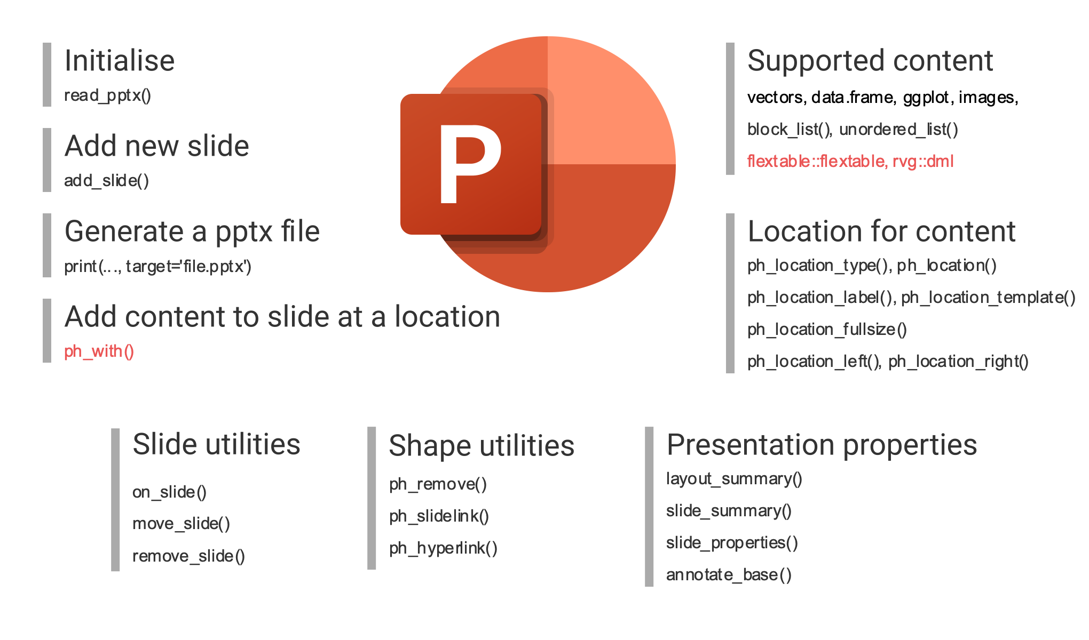

Slide 11
Going beyond officer
mschart to get native office charts in PowerPoint
Remember flextable?
rvg package to embed vector graphics (vector graphics look the same no matter the scale, so if you have a BIG presentation)

Slide 12
scales package

Slide 13


I scales

Slide 14
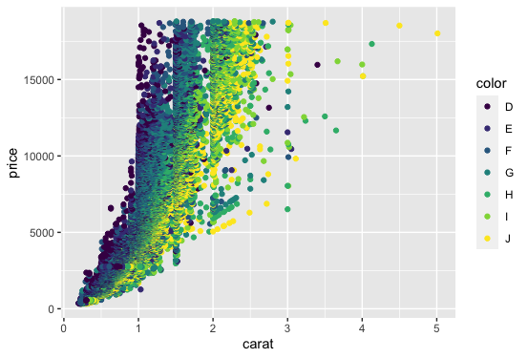
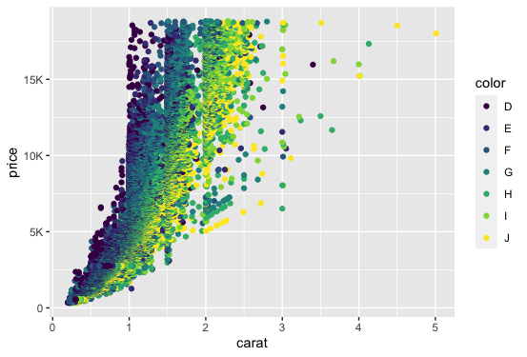
Diamonds label_number_si()

Slide 15
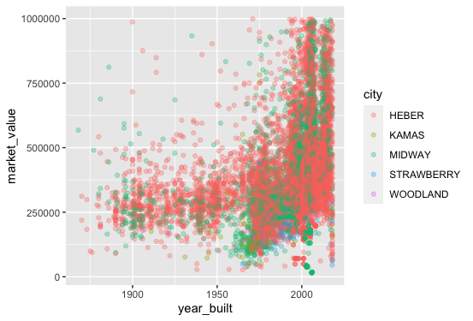
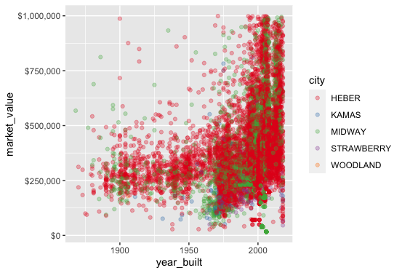
Houses label_dollar()

Slide 16
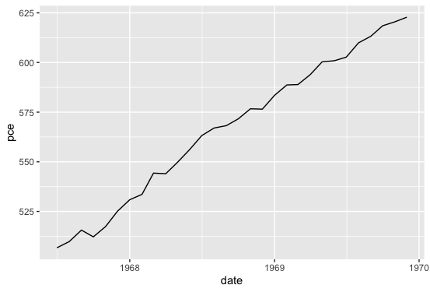
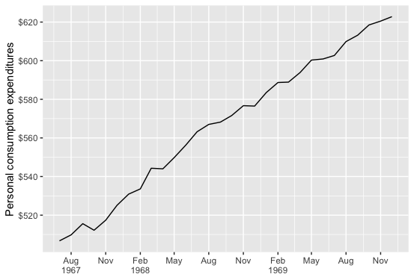
Economics label_dollar()

Slide 17
Homework

Slide 18
Homework 1
No Homework

